Slide 1

Correspondence Analysis:
Mental Health in Tech Survey
Niharika Bandlamudi
Notes:
Helo I am Niharika Bandlamudi today the presentation Is about Correspondence analysis on mental health in tech survey

Slide 2
The Business Challenge:
How can tech companies create a supportive environment for discussing mental health issues without employees fearing negative consequences?
Notes:
This dataset is from a 2014 survey that measures attitudes towards mental health and frequency of mental health disorders in the tech workplace
The survey primarily focuses on attitudes and perceptions regarding mental health disclosure in the tech workplace.
The dataset likely includes quantitative data capturing responses to the questions, categorized as "Yes," "No," or "Maybe," providing insights into the prevalence of concerns about discussing mental health issues.

Slide 3
Questions Considered for Analysis:
Demographic Questions:
Age
Gender
Work interfere
Company size
Do you think that discussing a mental health issue with your employer would have negative consequences?
If you have a mental health condition, do you feel that it interferes with your work?
Has your employer ever discussed mental health as part of an employee wellness program?
Notes:
The survey asked several demographic questions, including age, gender, work interfere, and company size.
There were also a number of questions regarding what public services should be prioritized, what If you have a mental health condition, do you feel that it interferes with your work.
All of responses were categorical choices.
For this analysis, I chose to explore if there was a relationship between age and mental health consequences.

Slide 4
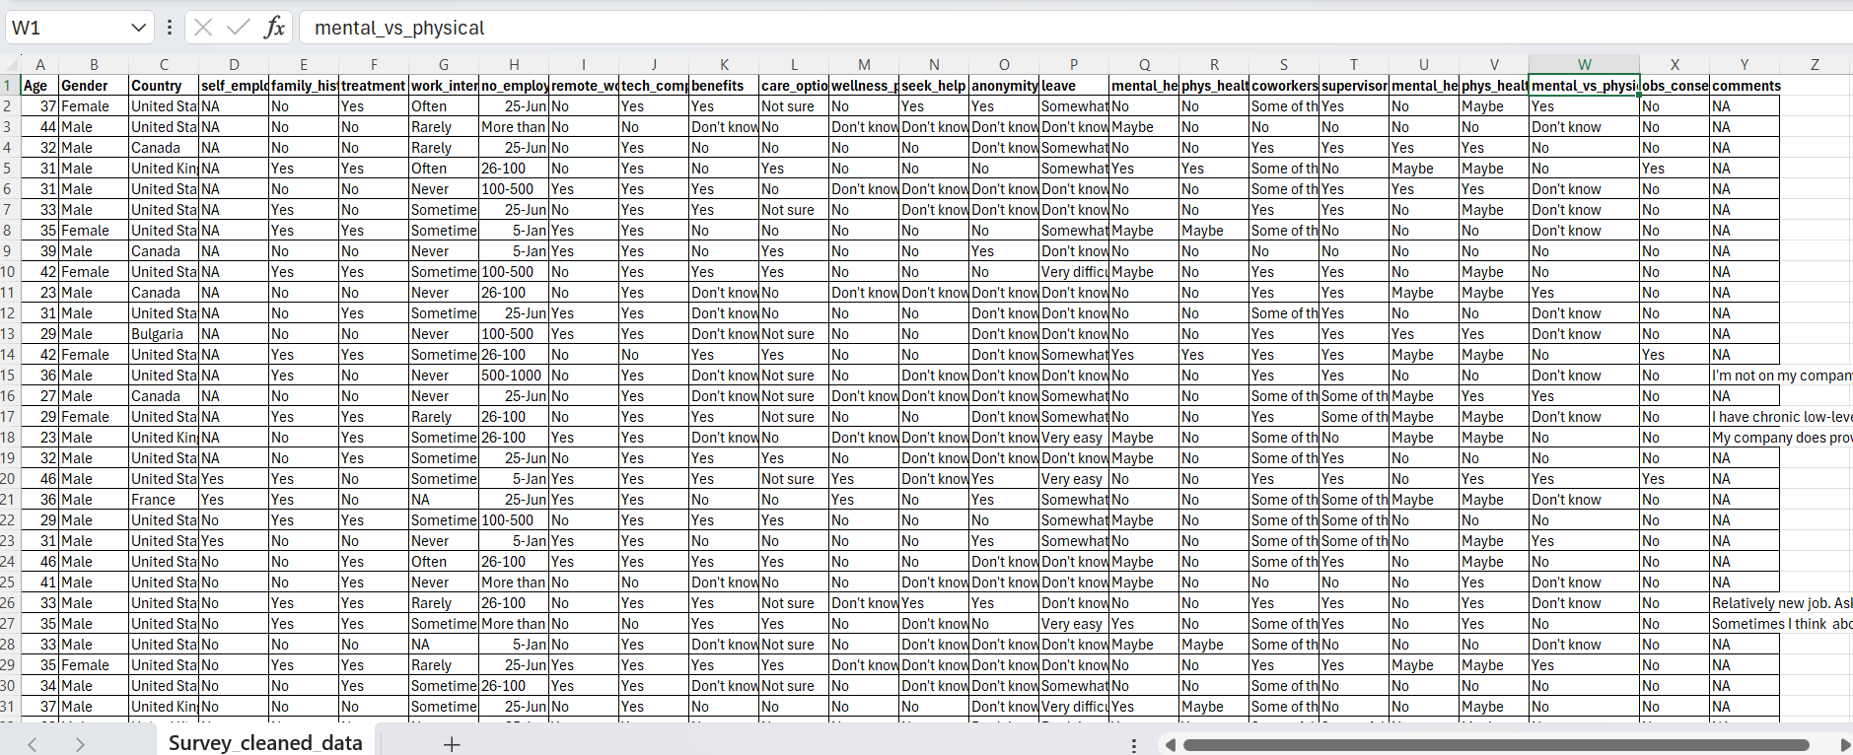
Cleaned Data:
Notes:
There were 1259 responses to the survey.
Here is a sample of the cleaned data.
Luckly,They are no missing responses in this survey data

Slide 5
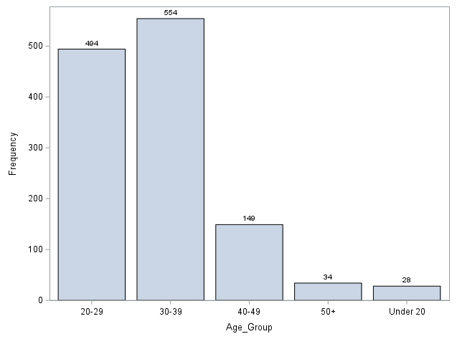
What is your age?
Under 20
20 – 29
30 – 39
40 – 49
50 years or older
Notes:
Respondents were asked to select their age range from five levels. There are under 20, 20-29, 30-39, 40-49 and above 50
As you seen in this plot

Slide 6

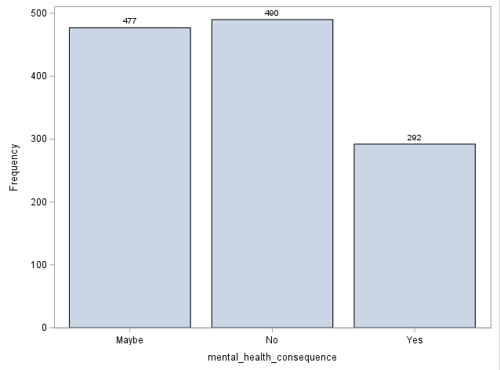
Do you think that discussing a mental health issue with your employer would have negative consequences?
Notes:
Discussing mental health issues with an employer can have varying consequences depending on the workplace context. The plot shows that many respondents believe there would be no negative consequences (“No”) about the outcomes, while a significant number are uncertain (“maybe”) . Some respondents do anticipate negative outcomes (“Yes”). It’s essential to assess your workplace, know your rights, and choose wisely when deciding whether to discuss mental health

Slide 7
Correspondence Analysis:
we can use a multivariate graphical technique to explore how different categories within the mental health tech survey data relate to each other.
Analysis:
Nominal Variables
No normal distribution
Categories are independent
Sample size is sufficient
Notes:
Correspondence analysis was a suitable method to explore the relationships between the categorical variables Age and mental health consequence in our survey data. This technique is based on several assumptions:
The variables under study must be nominal or categorical.
The categories within each variable should be independent of each other.
There should be an adequate sample size for each category of the variables.
Unlike some other methods, correspondence analysis does not assume a normal distribution of the data.
I chose to perform the correspondence analysis in SAS because it provides clearer and more detailed output tables compared to other software.

Slide 8
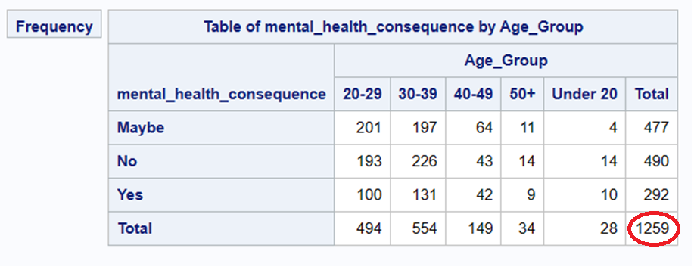
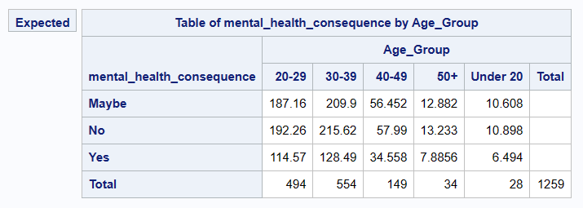
Observed vs Expected:
Notes:
The contingency tables for observed and expected shows The total of 1259 represents the number of responses where both the age and the Mental health consequences were provided.

Slide 9
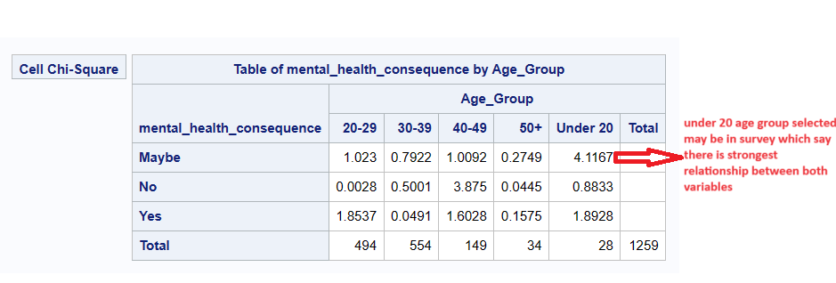
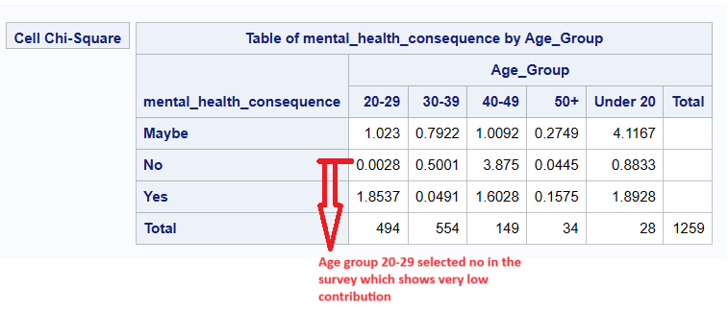
Chi-Square Contribution:
Notes:
The table shows how much each cell contributes to the total chi-square in the contingency table. The cell that contributes the most is “Maybe" for Under 20 years age group, with a contribution of 4.1167. Other cells with high contributions include “No" for 40-49-Age group range and the cell with the lowest contribution is “No" for 20-29-Age group range, which has a very low contribution of 0.0028.

Slide 10
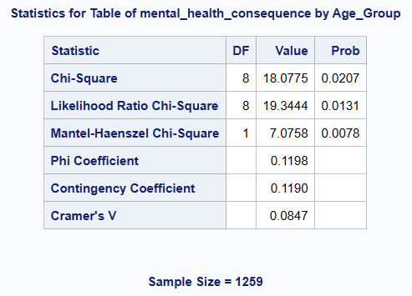
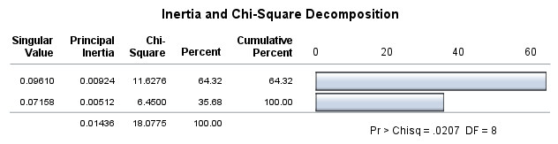
Chi-Square:
Notes:
the Chi-Square statistic yielded a p-value of less than 0.05. This significant result allows us to reject the null hypothesis and conclude that there is indeed a relationship between age and their mental health consequences.

Slide 11
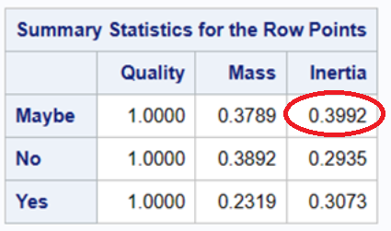
Summary Statistics for row points
Notes:
When considering mass, inertia, and quality, all row points exhibit high quality. Among these factors, Maybe stands out with highest inertia. This indicates that Maybe contributes the most to explaining the variation in the dataset.

Slide 12
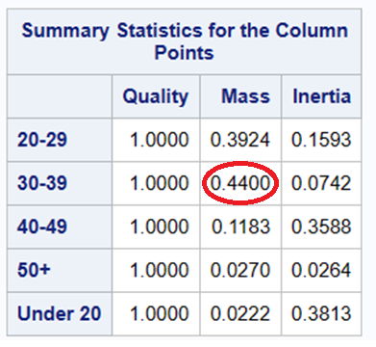
Summary Statistics for column points
Notes:
All column points demonstrate high quality. Within the groups, the 30-39 age group has the highest mass and followed by 20-29 age group has the second highest mass, indicating its importance in the analysis. On the other hand, the under 20 age group exhibits the highest inertia.

Slide 13
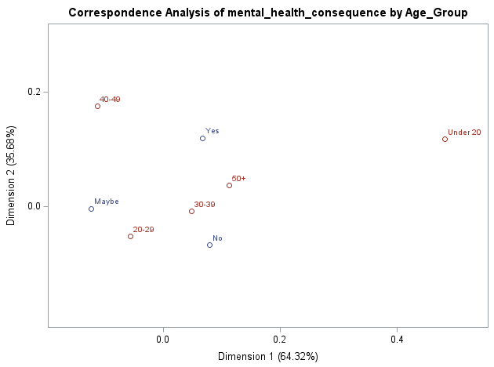
Notes:
Here is the Correspondence Analysis Plot. Age is shown in red, Mental health consequence is shown in blue.
Dimension 1 explains 64.32% of the variance and Dimension 2 explains 35.68% of the variance.

Slide 14
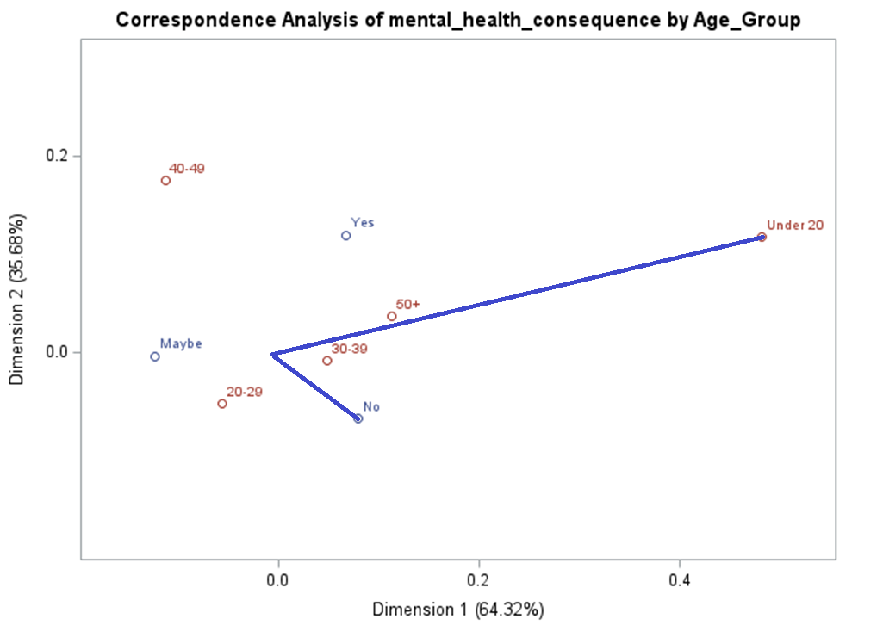
Notes:
In the context of age, we observe that the age group under 20 is highly distinct as it is positioned far from the origin. Similarly, the attribute "no" is also highly discriminating.
Additionally, when there is a small angle connecting a row and column label to the origin, it indicates a likely association between them. In this dataset, there appears to be a strong relationship between the attribute "no" and the age group under 20.

Slide 15
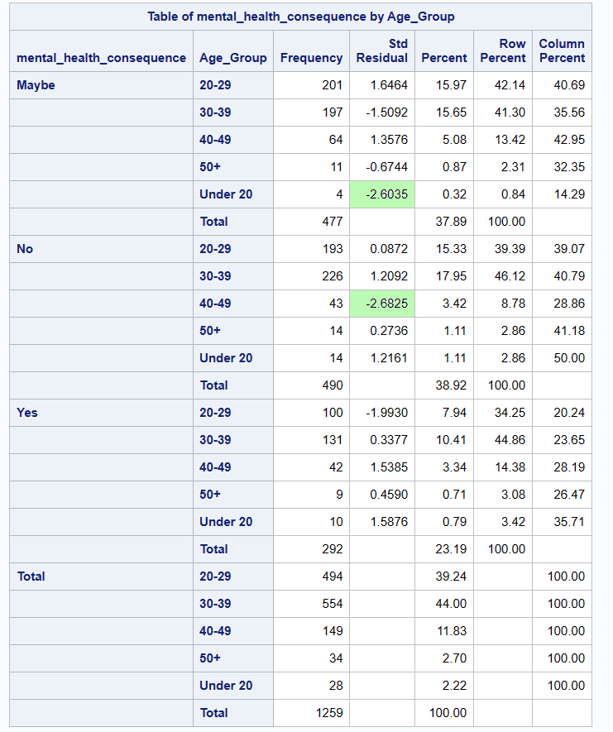
Notes:
With the plot, we’re just eyeballing what we think the relationship is.
But we can use standard residuals to determine if a cell is a source of significance.
As we learned in class, any cell with an adjusted residual of -2.0 or more can be considered a source for the significant result.
Here, the light green shows the residuals higher than -2. which are the source for the significant result.
Where these numbers are positive, it shows that there are more people observed here than expected
Where these numbers are negative, it means there are fewer people observed than expected

Slide 16
Conclusion:
Notes:
Based on the analysis, i found a strong link between age and mental health outcomes in the dataset. The age group under 20 and the attribute "no" were particularly important in predicting mental health consequences. The standard residuals and Chi-Square statistic supported this, showing deviations from expected frequencies that pointed to a significant relationship.
These findings highlight the importance of considering age in mental health interventions. Understanding how different age groups are affected can help tailor support services effectively. Overall, this study underscores the need for age-specific approaches in addressing mental health challenges.

Slide 17


